Slide 1


Intermediate Statistics
Tameka Gillett

Slide 2
Scenario Requirements
Determine what analysis you would run
Conduct an a priori power analysis to determine the sample size for that analysis
Then report your chosen test and the required sample size

Slide 3
Scenario 1
A company is hoping to collect data about the different marketing strategies they have undertake via social media. They want to measure the number of people who follow their posts on Facebook, Twitter, and LinkedIn to determine if one site works better than the others.
3 IV’s: Facebook, Twitter and LinkedIn
1 IV: number of people. Which works better?
Running an Anova

Slide 4
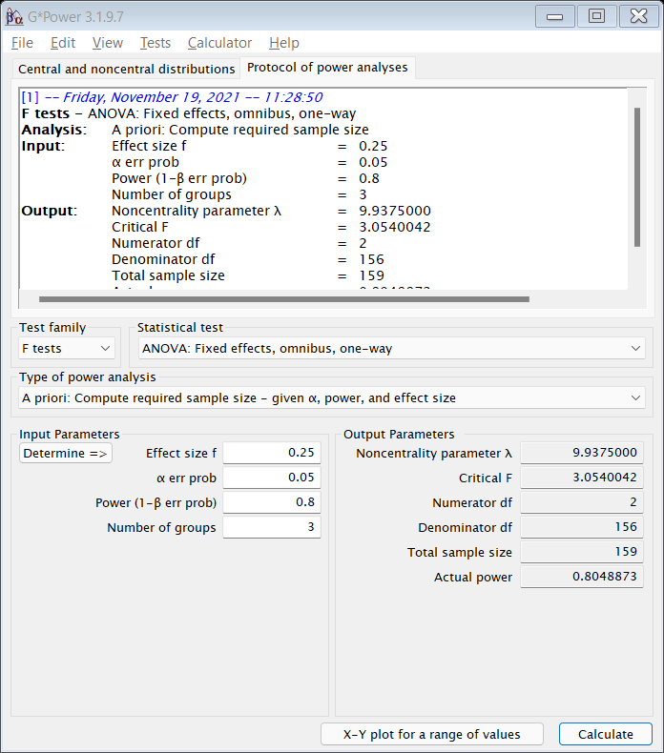
ANOVA: Fixed effects, omnibus, one-way
Total n: 159

Slide 5
Scenario 2
You have been hired to predict how roofing companies will fare in the upcoming years. There are several predictors: yearly hurricanes, winter storms, shingle prices, and GDP.
Predict signifies linear regression
DV: roofing companies
IV’s: yearly hurricanes, winter storms, shingle prices, and GDP
Predictors: 4

Slide 6
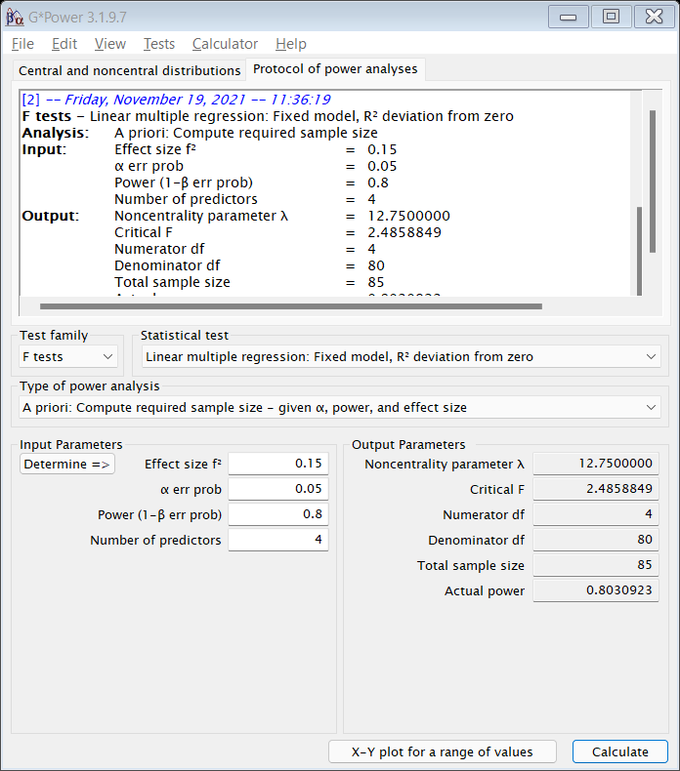
Linear Multiple Regression: Fixed Model
Total n: 85

Slide 7
Scenario 3
A hospital has contracted with you to determine how to improve patient care, as measured continuously by both pain level and disability level. They are examining these metrics upon admission to the hospital and at discharge from the hospital, and they are comparing their current standard of care to one where they check on the patients every hour.
DV’s: related continuous, pain and disability levels
Using a Manova
2 categorical’s: admission and discharge showing change over time

Slide 8
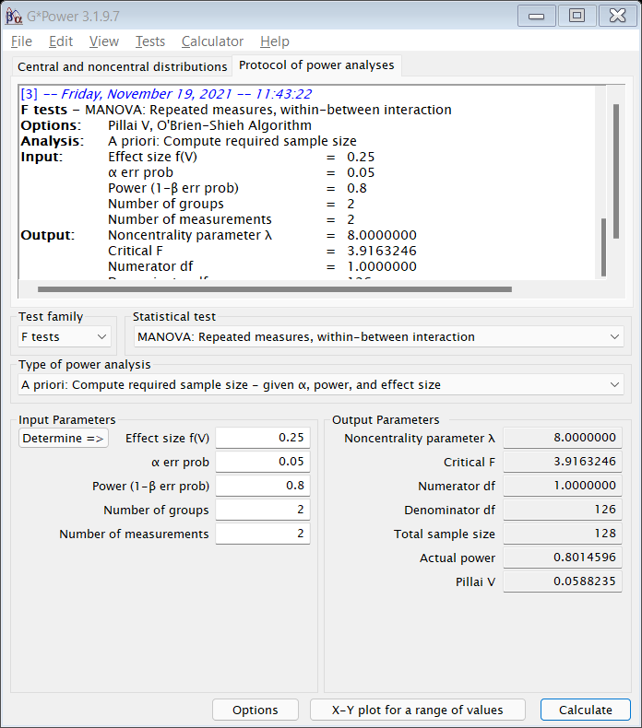
MANOVA: Repeated measures, w/in-between
Total n: 128

